Slide 1



IN THE NAME OF ALLAH THE MOST GRACIOUS, THE
MOST MERCIFUL

Slide 2

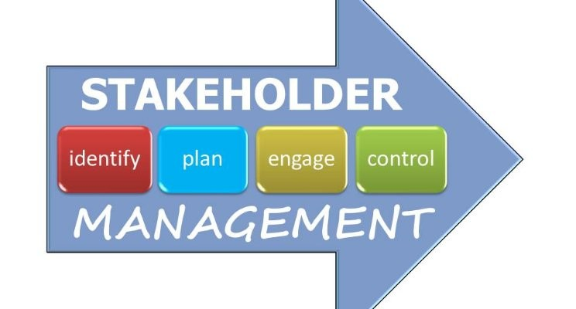
STAKEHOLDERS MANAGEMENT

Slide 3
KEY LEARNING OBJECTIVES
LO1 - Understand Relationship between Business & Society
LO2 - What is a Stakeholder and its Theories?
LO3 - Kinds of Stakeholders
LO4 - How to conduct Stakeholder Analysis?
LO5 - What PMBOK 6th Edition says about Stakeholders Management?
LO6 - Project Stakeholder Management Processes

Slide 4
Business & Society: An interactive System
Business – The term business refers here to any organization that is engaged in making a product or providing a service for a profit. It vary greatly in size and impact
Society –
  In its broad sense refers to human beings and to the social infrastructures they collectively create
  In more specific sense, refer to segments of humankind, such as members of a particular community, nation, or interest group
Therefore, as a set of organizations are created by humans; business is clearly a part of society
Society
Business

Slide 5
A Systems Perspective
General Systems Theory
  First introduced in 1940s, argues that all Organisms are open to, and interact with, their external environment. Eg: In Botany, the growth of plant cannot be explained without reference to soil, light, oxygen, moisture and other environmental characteristics
  Although most organisms have clear boundaries, they cannot be understood in insolation, but only in relationships to their surroundings
  As part of management theory, the systems concept implies that business firms (social organisms) are embedded/fixed in a broader social structure (external environment), with which they constantly interact
  Corporations have ongoing boundary exchanges with customers, governments, competitors, suppliers, communities and many other individuals/groups just as good soil, water, and light help a plant to grow
  Therefore, the key to business survival often is this ability to adapt effectively to changing conditions
  System Theory helps us understand how business and society, taken together, form an interactive social system (each needs the other, and each influences the other)

Slide 6
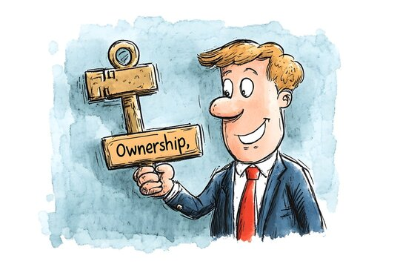

STAKEHOLDER THEORY OF FIRM
Ownership Theory of Firm
  Sometimes also called property or finance theory
  The Firm is seen as the property of owners
  Purpose of firm is to maximize its long-term market value to make money for shareholders
  Managers and Board of Directors are agents of shareholders having no obligations to others, other than specified by law
  In this view, owners interests are paramount taking precedence over the interests of others
Stakeholder Theory of Firm
  Argues that corporations serve a broad public purpose: to create values for society
  Companies must make a profit for their owners, however, they should also create other kinds of values such as professional development for employees and innovative new products for customers
  In this view, corporations have multiple obligations, and all stakeholders interests must be taken into account

Slide 7
STAKEHOLDER THEORY OF FIRM
Core Arguments
Descriptive Argument: Stakeholder view is simply a more realistic description of how companies really work. In addition to quarterly and annual financial performance by managers, they have to direct their energies towards all stakeholders and not just owners
Instrumental Argument: It is more effective as a corporate strategy. Companies behaving responsibly towards multiple stakeholders groups perform better financially, over the long run. Good relationships with stakeholders is a source of value for the firm
Normative Argument: Stakeholder management is simply the right thing to do. Owners and all stakeholders, contribute some value to the corporation

Slide 8
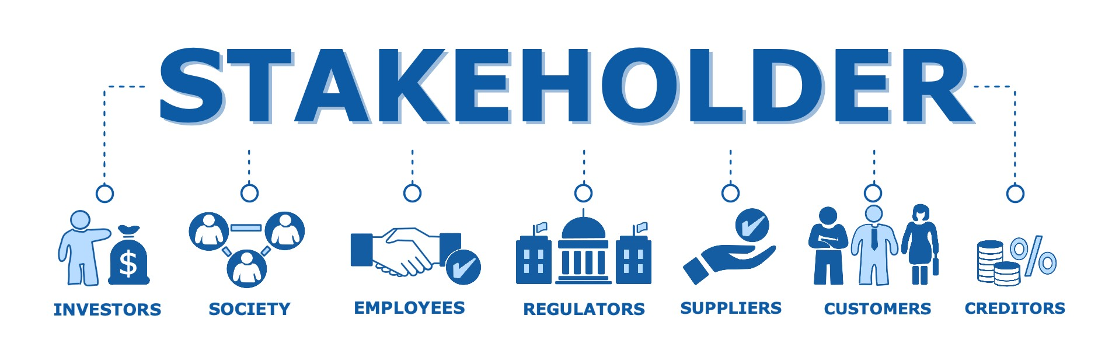
STAKEHOLDER CONCEPT
The word stake means an interest in or claim on a business enterprise
Those with a stake in the firm’s action includes diverse groups as customers, shareholders (stockholders), governments, suppliers, employees, professional and trade associations, social and environmental activists and NGOs
The term Stakeholder refers to an individual, group, organization that may affect by, or perceive itself to be affected by a decision, activity, ot outcome of a project, program, or portfolio (PMBOK 7)

Slide 9
KINDS OF STAKEHOLDER
Market Stakeholders: Are those in economic transactions with the company as it carries out its purpose of providing society with goods and services such as:
  Stockholders invest to receive dividends
  Creditors loan money and collect payments of interests
  Employees contribute their skills and knowledge in exchange of wages, benefits, professional development etc
  In return for payment, suppliers provide raw material, energy, services, finished products etc, wholesalers, distributors, and retailors engage in market transactions
Non-market Stakeholders: In contrast, are people and groups who are not directly engaged in economic exchange but are affected by or can affect its actions such as :
  The Community
  Various levels of Government
  NGOs
  Competitors
  General public etc

Slide 10
ANOTHER KINDS OF STAKEHOLDERS
Internal Stakeholders: Are those such as employees and managers, who are employed by the firm. They are “inside’ the firm, as they contribute their effort and skill, usually at a company worksite
External Stakeholders: Are by contrast, are those who although they may have important transactions with the firm-are not directly employed by it

Slide 11
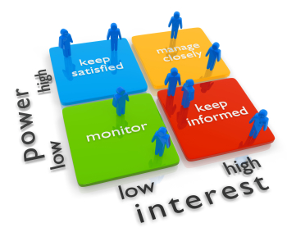
STAKEHOLDER ANALYSIS
An important part of the modern manager’s job is to identify relevant stakeholders and to understand their interests and the power they may have to assert these interests. This process is called “Stakeholder Analysis”.
STAKEHOLDER ANALYSIS-PMBOK 7
A method of systematically gathering and analyzing quantitative and qualitative information to determine whose interests should be taken into account throughout the project

Slide 12
COMPLEX STAKEHOLDERS WEB
NGOs
Employees
Creditors
Customers
Business Firm
Governments
NGOs
Suppliers
Competitors

Slide 13
STAKEHOLDER ANALYSIS- 4 KEYS QUESTIONS
Who are the relevant stakeholders?
What are the interests of each stakeholder?
What is the power of each stakeholder?
How are the coalitions/mergers likely to form?

Slide 14
STAKEHOLDER ANALYSIS- 4 KEYS QUESTIONS
Who are the relevant stakeholders? Identify and map relevant Stakeholders
What are the interests of each stakeholder? Their concern and what do they want Eg. Employees want fair compensation
What is the power of each stakeholder? Voting power, economic power, political power, legal power, and informational power
How are the coalitions likely to form? Stakeholders interests often coincide. They then form coalitions

Slide 15
Identify
Monitor
Understand
Engage
Analyze
Prioritize
“Navigating Effective Stakeholder Engagement”
(PMBOK-7)

Slide 16









STAKEHOLDER SATISFACTION
Net Promoter Score – NPS measures the degree to which a stakeholder (customer) is willing to recommend a product or service to others (Range from -100 to + 100)
Mood Chart
Morale
Turnover
 | Sunday | Monday | Tuesday | Wednesday | Thursday | Friday | Saturday
Owais Khan
Pakiza Khan
Umair Khan
Adnan Khan

Slide 17
PROJECT STAKEHOLDER MANAGEMENT
(PMBOK-6 GUIDELINES)

Slide 18
PROJECT STAKEHOLDER MANAGEMENT
Includes:
  The processes required to identify the people, groups, or organizations that could impact or be impacted by the project
  To analyze stakeholder expectations and their impact on the project, and
  To develop appropriate management strategies for effectively engaging stakeholders in project decisions and executions

Slide 19
PROJECT STAKEHOLDER MANAGEMENT PROCESSES
13.1 Identify Stakeholders – The process of identifying stakeholders regularly and analyzing and documenting relevant information regarding their interests, involvement, interdependencies, influence, and potential impact on project success
13.2 Plan Stakeholder Engagement – The process of developing approaches to involve project stakeholders based on their needs, expectations, interests, and potential impact on the project
13.3 Manage Stakeholder Engagement – The process of communicating and working with stakeholders to meet their needs and expectations, address issues, and foster appropriate stakeholder engagement involvement
13.4 Monitor Stakeholder Engagement – The process of monitoring stakeholder relationships and tailoring strategies for engaging stakeholders through the modification or engagement strategies and plans

Slide 20
PROJECT STAKEHOLDER MANAGEMENT OVERVIEW
13.1 Identify Stakeholders
Inputs
1 Project Charter
2 Business documents
3 Project Management plan
4 Project documents
5 Agreements
6 Enterprise environmental
factors
7 Organizational process
assets
Tools & Techniques
1 Expert Judgment
2 Data gathering
3 Data Analysis
4 Data representation
5 Meetings
Outputs
1 Stakeholder register
2 Change requests
3 PMP updates
4 Project documents updates
13.2 Plan Stakeholder Engagement
Inputs
1 Project Charter
2 PMP
3 Project documents
4 Agreements
5 EEFs
6 OPAs
Tools & Techniques
1 Expert judgement
2 Data gathering
3 Data analysis
4 Decision making
5 Data representation
6 Meetings
Outputs
1 Stakeholder Engagement Plan
13.3 Manage Stakeholder Engagement
Inputs
1 Project Management plan
2 Project Documents
3 Enterprise environmental
factors
4 Organizational process
assets
Tools & Techniques
1 Expert Judgment
2 Communication skills
3 Interpersonal and team skills
4 Ground rules
5 Meetings
Outputs
1 Change requests
3 Project Management plan
updates
4 Project documents update
13.4 Monitor Stakeholder Engagement
Inputs
1 Project Management plan
2 Project Documents
3 Work performance data
4 Enterprise environmental
factors
5 Organizational process
assets
Tools & Techniques
1 Data analysis
2 Decision making
3 Data Representation
4 Communication skills
5 Interpersonal and team skills
6 Meetings
Outputs
1 Work Performance
Information
2 Change requests
3 Project Management plan
updates
4 Project documents updates

Slide 21

Key Concept!
The ability of the Project Manager and Team to correctly identify and engage all stakeholders in an appropriate way can make the difference between a project success or failure

Slide 22
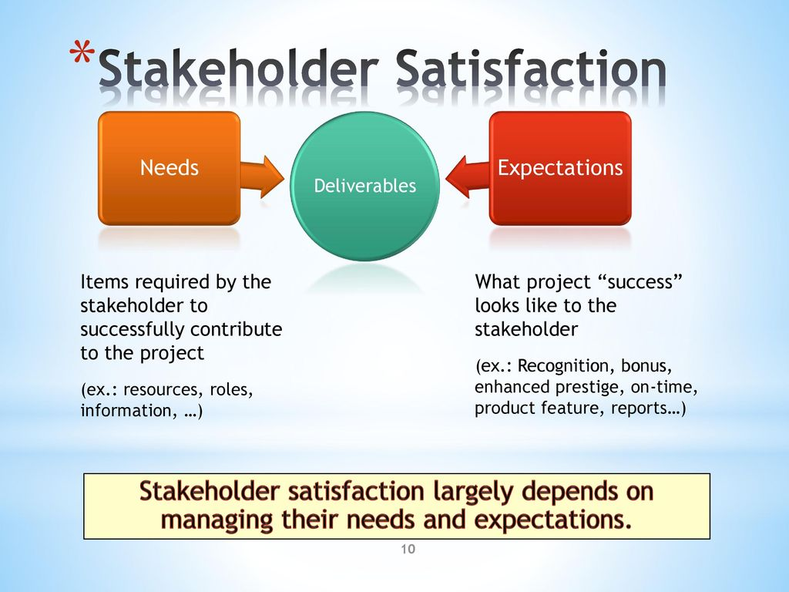
Key to SH Engagement!
As a Project Manager, focus on continuous communication with all stakeholders, including team members, to understand their needs and expectations, address issues as they occur, manage conflicting interests, and foster appropriate stakeholder engagement in project decisions and activities

Slide 23

Update SHs at least:
* When project moves through different phases in its life cycle
* When current stakeholders are no longer involved in the work of the project or new stakeholders joins
* When there are significant changes in the organization or the wider stakeholder community
* or as planned

Slide 24
13.1 Identify Stakeholders-Inputs
13.1.1.1 – Project Charter - Identify key stakeholder list and their responsibilities, if any
13.1.1.2 Business Documents - In the first iteration of the identify stakeholder process, the “Business Case” and the “Benefits Management Plan (BMP)” are the sources of information about project’s stakeholders
  Business Case – Identifies project objectives and identify an initial list of SHs
  Benefits Management Plan (BMP) – Describes expected plan for realizing the benefits claimed in the business case. It may identify individuals and groups that will benefit from the delivery outcomes of the project
13.1.1.3 Project Management Plan – Initially not available while identifying SHs but once prepared may include:
  Communication Management Plan (CMP) – Communications and stakeholder engagement are strongly linked. CMP is a big source of knowledge about SHs
  Stakeholder Engagement Plan – Identifies management strategies and actions required to effectively engage SHs

Slide 25
13.1 Identify Stakeholders - Inputs
13.1.1.4 Project Documents – It is unlikely that PDs will be an input for initial stakeholder identification. It continues throughout the project. Few documents which can help in SHs identification are:
  Change Log (Section 4.6.3.3) – May introduce a new stakeholder or change the nature of existing SH’s relationship to the project
  Issue Log (Section 4.3.3.3) – Records issues that may introduce new SHs or change the type of participation of existing SHs
  Requirements documentation (Section 5.2.3.1) – Requirements can provide information on potential SHs
13.1.1.5 Agreements– The parties of an agreement are project SHs. Agreement can contain references to additional SHs
13.1.1.6 EEFs – EEFs which can influence like org culture, political climate, governance framework, geographical distribution of duties etc
13.1.1.7 OPAs – OPAs which can influence the identify SHs process are SH Register templates and instructions, SH register from previous projects, lessons learnt with info about preferences, actions, and involvement of SHs

Slide 26
13.1 Identify Stakeholders – Tools & Techniques
13.1.2.1 Expert Judgment (Section 4.1.2.1)– Expertise should be considered from expert individuals or groups on following:
  Understanding the politics and power structures in the organization
  Knowledge of environment and culture of organizations, other affected organizations including customers and the wider environment
  Knowledge of industry or type of project deliverable, and
  Knowledge of individual team member contributions and expertise
13.1.2.2 Techniques that can be used are:
  Questionnaires and surveys – Data Gathering one-on-one reviews, focus group sessions etc
  Brainstorming
    Brainstorming – A general data gathering technique that elicits input from groups such as team members or SMEs
    Brain writing – A refinement of brainstorming that allows individuals participants time to consider the question individually before the group creativity session is held using face-to-face or virtual environment

Slide 27
13.1 Identify Stakeholders – Tools & Techniques
13.1.2.3 Data Analysis– Techniques which can be used are:
  Stakeholder analysis: Results in getting relevant information such as SHs positions in the org, roles on the project, “stakes”, expectations, attitudes (their level od support),and their interest in information about the project
    Stakes can include:
      Interest – A person or group can be affected by a decision related to project or its outcomes
      Rights (Legal or moral rights) – Legal rights of a country for occupational health and safety; moral may involves concepts of protection of historical sites or environmental sustainability
      Ownership – A person or group has a legal title to an asset or property
      Knowledge – Specialist knowledge, which can benefit the project through more effective delivery etc
      Contribution – Provision of funds or other resources, including HR, or providing support in advocacy of promoting objectives or acting as a buffer between the project and power structures of the organization and its politics
  Document analysis (section 5.2.2.3): Assessing the available project documentation and lessons learned from previous projects to identify SHs and other supporting information

Slide 28
13.1 Identify Stakeholders – Tools & Techniques
13.1.2.4 Data Representation– Techniques which can be used are:
  Power/interest grid, power/influence grid, or impact/influence grid: Each supports a grouping of SHs according to their level of authority (power), level of concern (interest), ability to influence (Influence), or ability to cause changes to the project planning or execution (generally used for small projects or for projects with simple relationships between SHs and the project)
  Stakeholder Cube: This is a refinement of the grid models above. It combines elements into a three-dimensional model that can be useful for PMs and teams in identifying and engaging their stakeholder community.
  Salience Model: Describes classes of stakeholders based on assessments of their power (level of authority or ability to influence outcomes) urgency (need for immediate attention), legitimacy (their involvement is appropriate)- Useful for large complex communities of SHs or where we have complex relationships within community
  Directions of influence: Classifies SHs according to their influence on the work or project team itself. SHs can be classified as:
    Upward (Senior management, sponsor, steering committee etc)
    Downward (Team or specialists contributing in TY capacity)
    Outward ( SH groups and their representatives outside the project team. Such as suppliers, government departments, the public, end-users and regulators
    Sideward ( the peers of the PM)
  Prioritization: Prioritization of SHs may be necessary for projects with a large number of SHs, or SHs changing frequently, or when relationships between SHs and the project team or within SH community are complex
13.1.2.5 Meetings Used to develop an understanding of significant project SHs

Slide 29
13.1 Identify Stakeholders – Outputs
13.1.3.1 Stakeholder Register– This document includes but is not limited to:
  Identification Information: Name, organization position, location and contact details, role
  Assessment Information: Major requirements, expectations, potential for influencing project outcomes, and the phase of the project life cycle where the SH has the most influence or impact
  Stakeholder classification: Internal/external, impact/influence/power/interest, direction of influence (upward/downward, outwards, sideward), or any other classification model chosen by PM
13.1.3.2 Change Requests (Section 4.3.3.4) During first iteration of identifying SHs, there will be no change requests. But as we progress, new stakeholders join, or new information on SHs received, may result in change requests through PIIC (Performed Integrated Change Control)

Slide 30
How Stakeholders can affect a project?
Aspects | Affect
Scope/requirements | By revealing the need to add, adjust, or remove elements of scope and/or project requirements
Schedule | By offering ideas to accelerate delivery or by slowing down or stop delivery of key project activities
Cost | By helping to reduce or eliminate planned expenditures or by adding steps, requirements, or restrictions that increase cost or require additional resources
Project Team | By restricting or enabling access to people with the skills, knowledge, and experience needed to deliver the intended outcomes
Plans | By providing information for plans or by advocating for changes to work
Outcomes | By enabling or blocking work required for the desired outcomes
Culture | By establishing or influencing or even defining the level and character of engagement of the project team and broader organization
Benefits realization | By generating and identifying long-term goals to deliver value
Risk | By defining risk thresholds of project, as well as participating in risk management activities
Quality | By identifying and requiring quality requirements
Success | By defining success factors and participating in the evaluation of success

Slide 31
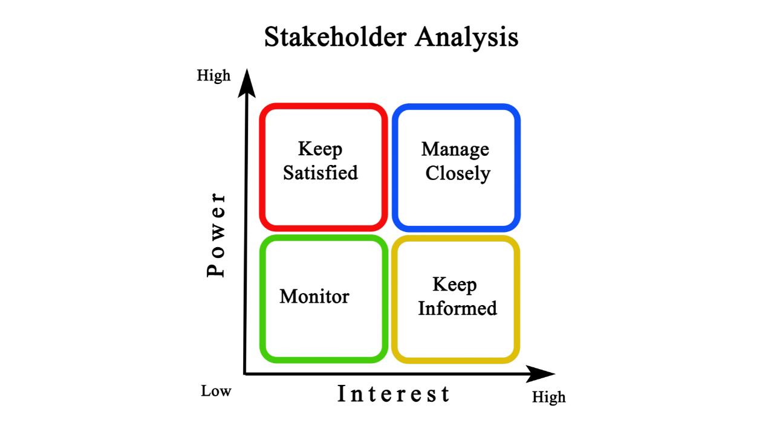
Stakeholders Analysis
Stakeholder Analysis using the Power and Interest Grid
The Power-Interest matrix also known as the Mendelow Matrix, was proposed by Aubrey Mendelow in 1991

Slide 32
Stakeholder Analysis using Stakeholder Cube Model
Conduct the analysis in a Diverse Team
Examine each stakeholder individually from three Perspectives
Evaluate the Current State

Slide 33
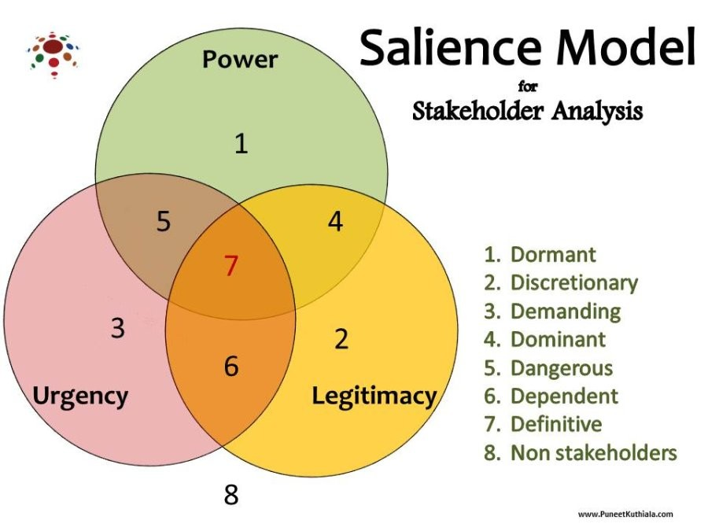
Developed by Ronald Mitchell, Bradley Agle, and Donna Wood in 1997

Slide 34
1 Dormant (Kind of sleeping) Stakeholder: They have power but don’t use it because they have no urgency or legitimacy. For e.g., A government minister who has influence but is not currently interested in your project.
2 Discretionary Stakeholders (Legitimacy only): They have legitimate claims but no power or urgency. For e.g., A charity organization asking for environmental responsibility from your company.
3. Demanding Stakeholders (Urgency only)
They have urgent needs but no power or legitimacy. E.g A customer who keeps complaining loudly but has no power or legitimate claim.
4. Dominant Stakeholder (Power + Legitimacy). They have both power and legitimacy. They influence decisions strongly. For e.,g Company owners or senior executives.
5. Dangerous Stakeholders (Power + Urgency)
They have power and urgent demands, but no legitimacy thus they may take extreme actions. For e.g., A labor union threatening to go on strike without legal justification.
6. Dependent Stakeholders (Legitimacy + Urgency)
Their claim is urgent and legitimate but they lack power , thus they depend on you. For e.g., Local community affected by your factory operations.
7. Definitive Stakeholders (All three attributes)
They have power + legitimacy + urgency thus opt for top priority stakeholders. For e.g Project sponsor who has full power, legitimate authority, and urgent deadlines.
8. Non-Stakeholders :They hold none of the three attribute for e.g, People who are completely unrelated to the company or project

Slide 35
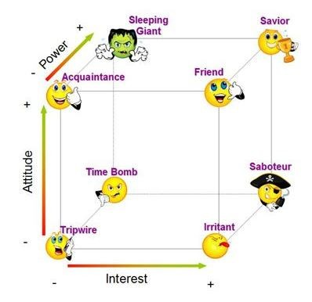
Various Characters
Stakeholder Cube

Slide 36
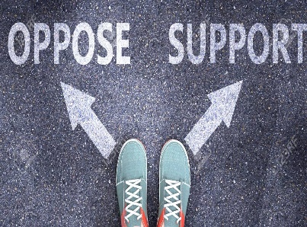


Three Grid of Model
Attitude Grid - Do they offer support? or Do they express opposition?
  Subsequent Questions
  Is there a clash of interests between the stakeholder and the project?
  Does the stakeholder exhibit emotional endorsement of the project?
  Is the stakeholder voicing opposition to the project?
  Is the stakeholder demonstrating actions in favor of the project?
Power Grid - Do they possess the capability to impact the project?
  Subsequent Questions
    Is the stakeholder positioned to exert an impact on the project's direction?
    Can the stakeholder play a role in steering the project away from a crisis?
    Could the stakeholder's actions contribute to the project's failure?
    Does the stakeholder possess the ability to influence project sponsors?
    Does the stakeholder hold influence over key members of the project team?
Interest Grid - Do they emotionally committed to the project?
  Subsequent questions
    Is the stakeholder present at project meetings?
    Does the stakeholder engage in discussions related to the project?
    Is the stakeholder actively seeking relevant information about the project?
    Does the stakeholder exhibit signs of willingness to participate in the project?

Slide 37





 | Eight Characters of Model
Savior | Influential active backer (High Power - Positive Attitude - High Interest) E.G CEO who strongly supports the project. Primary Strategy: Prioritize them, further strengthen the bonding. Secondary Strategy: Maintain their interest, show them the potential.
Sleeping Giant | Influential passive backer (High Power - Positive Attitude - Low Interest) E.G A senior director who likes your project but doesn’t actively engage. Primary Strategy: Gain their interest. Align and communicate their benefit. Secondary Strategy: Keep them informed. Ensure information always available.
Saboteur | Influential active blocker (High Power - Negative Attitude - High Interest) Example: A competitor inside the company who wants your project to fail. Primary Strategy: Convert their Attitude, realign the conflict, reframe the scenario. Secondary Strategy: Reduce their Power, tone down their scope, damage control.
Time Bomb | Influential passive blocker (High Power - Negative Attitude - Low Interest) Example: A finance head who does not care about the project but can stop your funding anytime. Primary Strategy: Maintain their low interest, stay low profile. Secondary Strategy: Further reduce their interest, isolate them from any news.
Friend | Insignificant active backer (Low Power - Positive Attitude - High Interest) A motivated junior team member supporting your project. Primary Strategy: Improve their Power, find opportunity to bring them into your project. Secondary Strategy: Keep them as a Friend, moral support is also crucial.

Slide 38



 | Eight Characteristics of Model
Acquaintance (Kind of Know-how) | Insignificant passive backer (Low Power - Positive Attitude - Low Interest) Primary Strategy: Keep them informed with no expectation. Secondary Strategy: Work on their interest, good to have more friends. A junior member from a different department. They appreciate your work, but their decisions cannot impact your project, and they don't want to dedicate much time to it either.
Irritant | Insignificant active blocker (Low Power - Negative Attitude - High Interest) Primary Strategy: Avoid power gain, manage their expectation. Secondary Strategy: Reduce their interest, keep them busy. A team member who prefers the old system and constantly points out flaws in your new software solution.
Tripwire | Insignificant passive blocker (Low Power - Negative Attitude - Low Interest) Primary Strategy: Isolate information, keep them far from your project. Secondary Strategy: Monitor their interest, don't let them come near. An older employee in another division who considers the project unnecessary. Since the project is outside their domain, their interest is low. However, if they stumble and make blunder upon information that could harm your project, they wouldn't hesitate to use it.

Slide 39
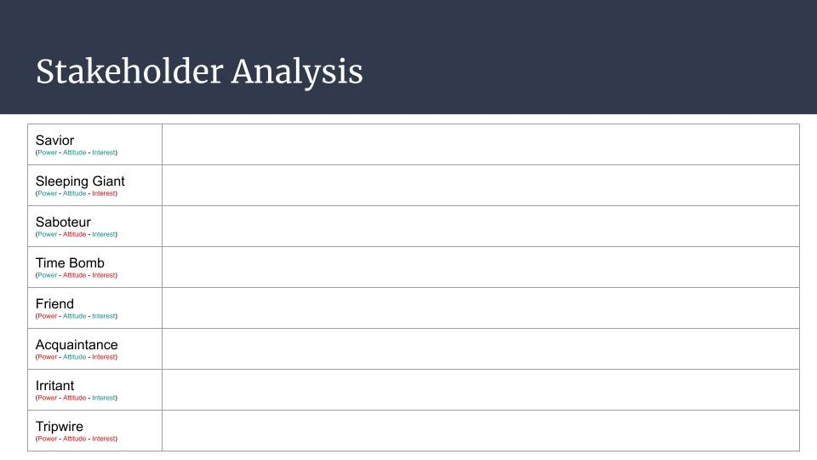

Slide 40
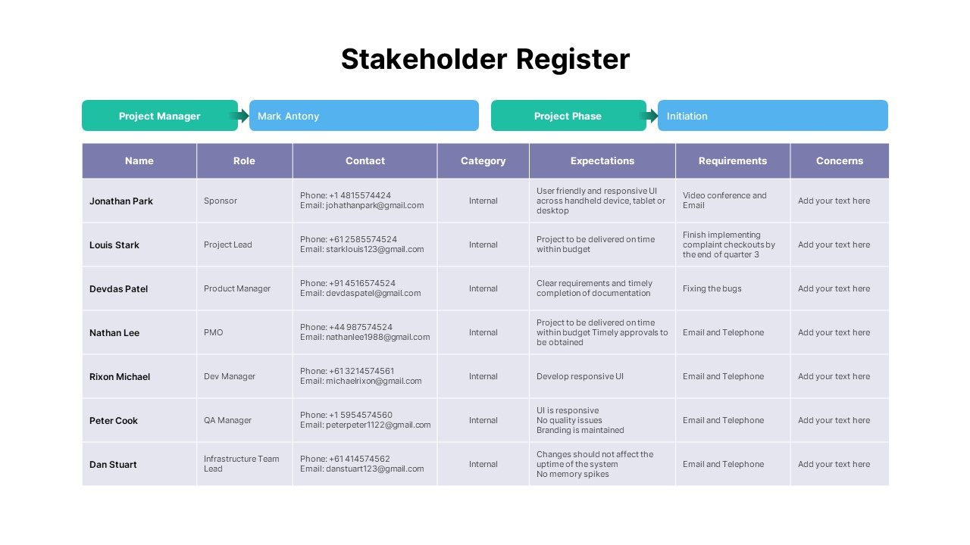

Slide 41
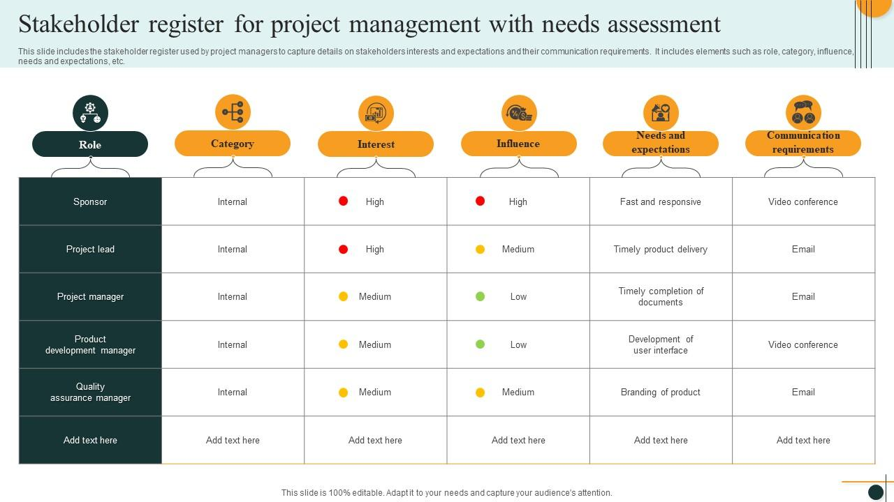

Slide 42
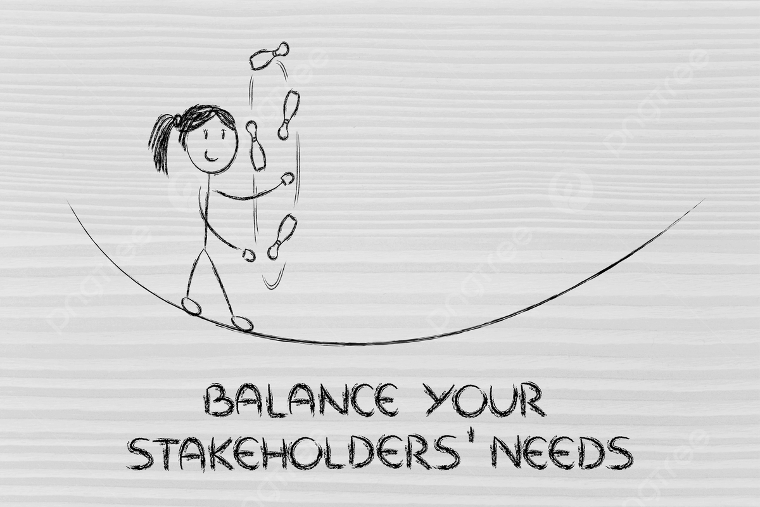
THANK YOU

Slide 43
